Slide 1
Particle Physics Event Classification
In particle physics, accurate event classification is key to understanding fundamental particles. Using features from experimental data, we built a machine learning model to classify events into Signal (s) and Background (b), helping separate meaningful signals from noise.

Slide 2
DATA Overview
1
Dataset Size
250001 rows and 33 columns of Particle Physics Event Classification data
2
Key Features
Weight,DER_mass_MMC,DER_mass_transverse_met_lep,PRI_tau_pt,DER_mass_vis,DER_met_phi_centrality,DER_pt_ratio_lep_tau,DER_deltar_tau_lep,DER_prodeta_jet_jet,DER_lep_eta_centrality
3
Target Variable
whether a given set of experimental features corresponds to a signal or background event (yes/no)

Slide 3
DATA PREPROCESSING
1
Handling missing Values
Used mean and median imputation for numerical variable.
2
Handling Imbalance dataset
Handle the imbalance dataset with SMOTE (Synthetic Minority Over-sampling Technique) technique to address class imbalance by generating synthetic samples of the minority class
3
Dimensionality reduction
To reduce dimensionality and remove noise while retaining the most informative features for classification

Slide 4
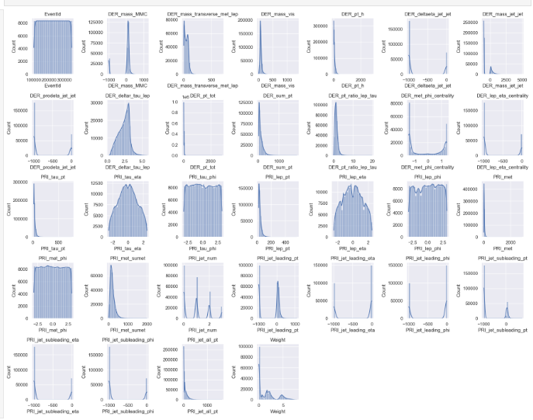
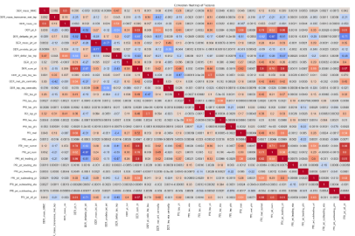
Exploratory Data Analysis
Correlation Analysis
histogram plots
To visualize how each feature contributes to separating the signal from the background.
Heatmap revealed relationships between variables, guiding feature selection.

Slide 5
Model Selection
Baseline Models
Tree-based Models
Advanced Models
Logistic Regression for baseline performance.
Random Forest for capturing non-linear relationships.
XGBoost for potentially higher accuracy, handles missing data, flexible with feature types

Slide 6
Model Training and Evaluation
Data Splitting
Performance Metrics
80% training, 20% testing split for model evaluation.
Evaluated models using Precision, Recall, F1-Score and ROC-AUC Score.
1
2
3
Model Training
Logistic Regression, Random Forest, XGBoost were utilized as classification models.

Slide 7
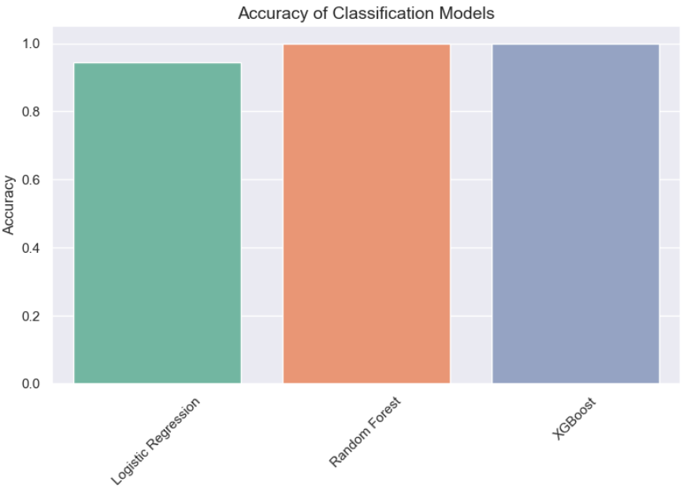
Model Performance Comparison
Best Performer
Baseline
Random Forest Classifier and XGBoost achieved highest accuracy rate is 100
Logistic Regression achieved an accuracy of approximately 0.94.

Slide 8
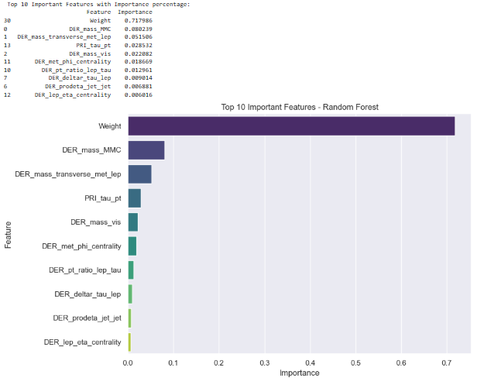



Feature Importance
Weight
Most important feature with 71% importance.
DER_mass_MMC
Second important feature “DER_mass_MMC” at 8%
DER_mass_transverse_met_lep
“DER_mass_transverse_met_lep “ contributed 5%

Slide 9
THANK YOU

